Slide 1
ROOM VENTILATION & CONTROL SYSTEM
Presentation by
ASHNA NIZAM
S1E1

Slide 2
INTRODUCTION
People spent one-third of their life Sleeping and is highly essential to human health and wellbeing. However, bedrooms with the doors and windows closed for acoustic privacy and energy conservation are often poorly ventilated.
Use of TV and computer in bedrooms also increase the risk of air pollution.

Slide 3
Research findings show that in closed rooms the CO2 concentration increase to more than 2500ppm (normal level is around 350ppm only) and lead to disturbed sleep, headache, reduced performance levels and other health hazards compared to open ventilated rooms.
This is a serious health hazard most of us are unaware of.

Slide 4
As the temperature raises, even small homes started to install Air conditioners in their bedroom.
While installing Air conditioners, the ventilators are closed to provide heat insulation and energy conservation.
In a state like Kerala where there is rain for 6 months, the Air conditioners are kept idle during this period and no one bothers to open the ventilators.
The inmates then sleep in these poorly ventilated rooms risking their health

Slide 5
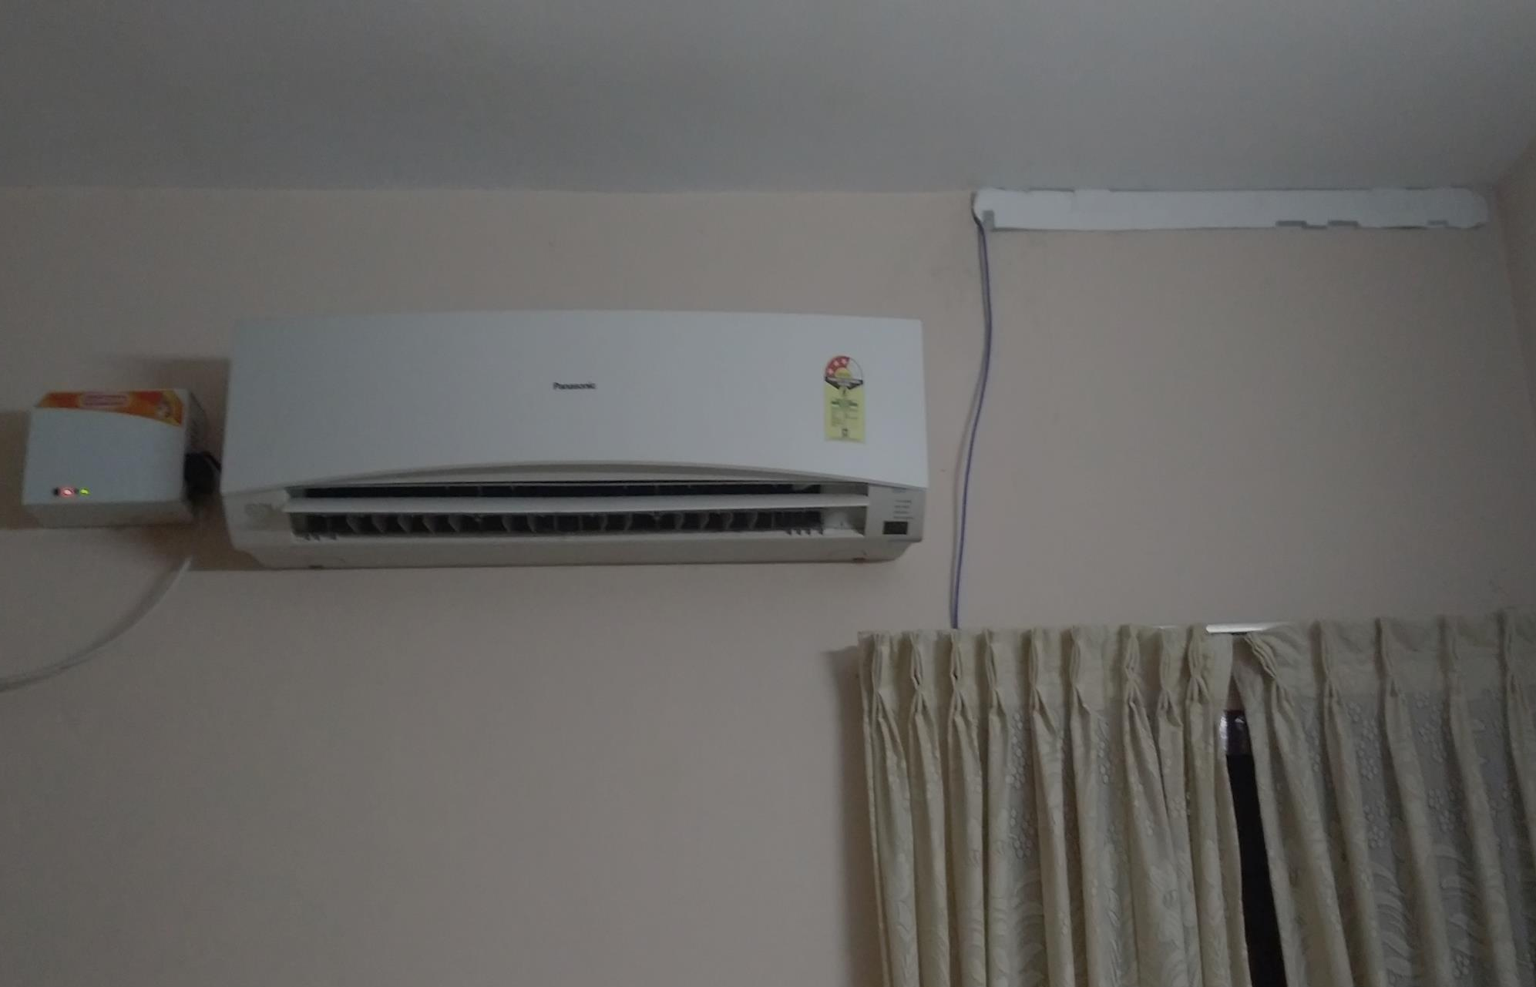
PHOTOGRAPH SHOWING THE TYPICAL CASE
WHERE VENTILATORS ARE CLOSED

Slide 6
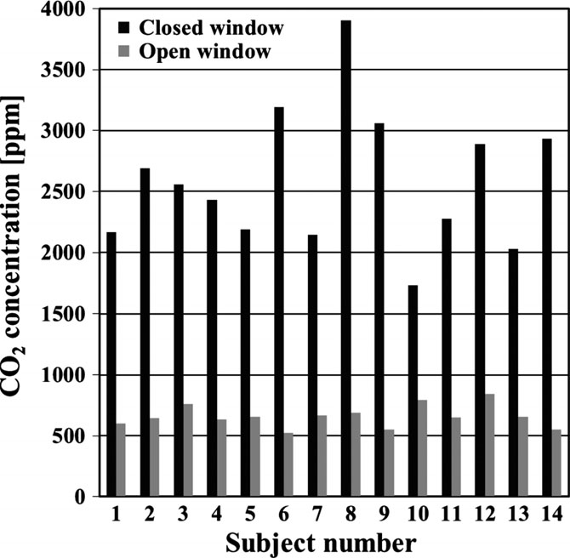
Comparison of the CO2 concentration during night-time, each bar representing a 4-day average

Slide 7
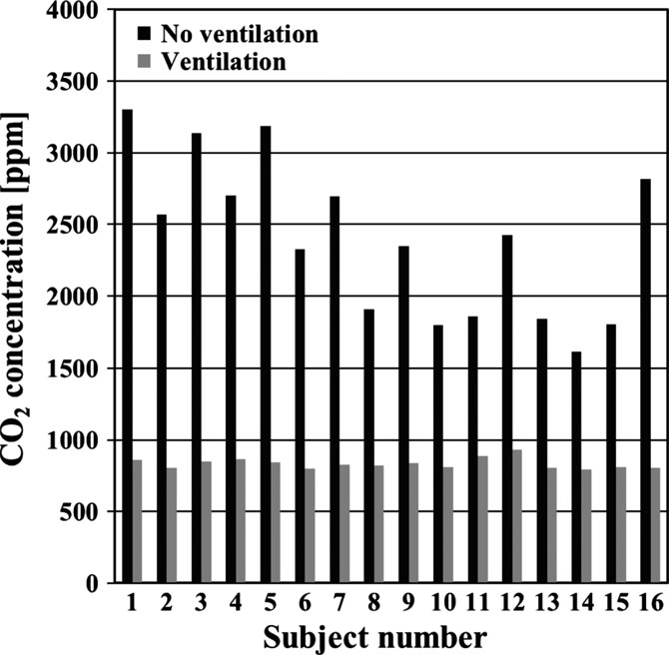

Slide 8
OBJECTIVE
“To Develop a system which offers an effective solution for improving the bedroom air quality which is fitted with Air conditioners by dynamically controlling Ventilators”

Slide 9
PROOF OF CONCEPT
PROOF OF CONCEPT WAS DEVELOPED USING ARDUINO MICRO CONTROLLER
PRESENTED TO “ I AM KALAM” ALL KERALA SCIENCE EXHIBITION.
AND SELECTED TO THE FINAL 10.

Slide 10
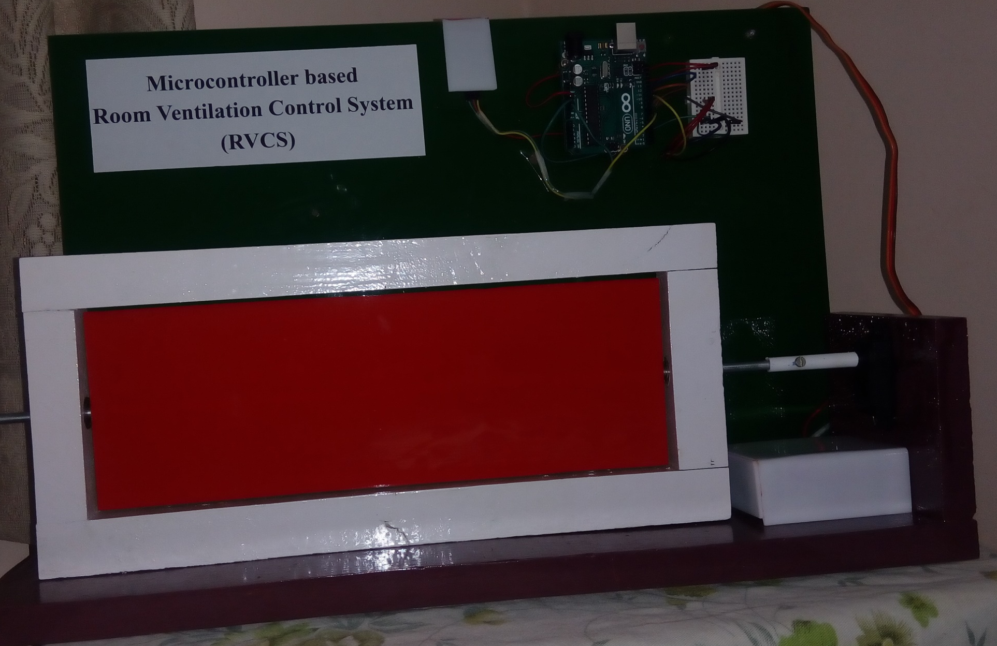
PROOF OF CONCEPT

Slide 11
METHODOLOGY
The project is to be developed using ARDUINO micro controller and Infra-red sensor (SM0038 IR receiver). The system is optimized to work with LG AC remote. Arduino receives the signal from an IR sensor that it receives from the AC remote and processes the signal to dynamically control a mechanical ventilation closure system.

Slide 12
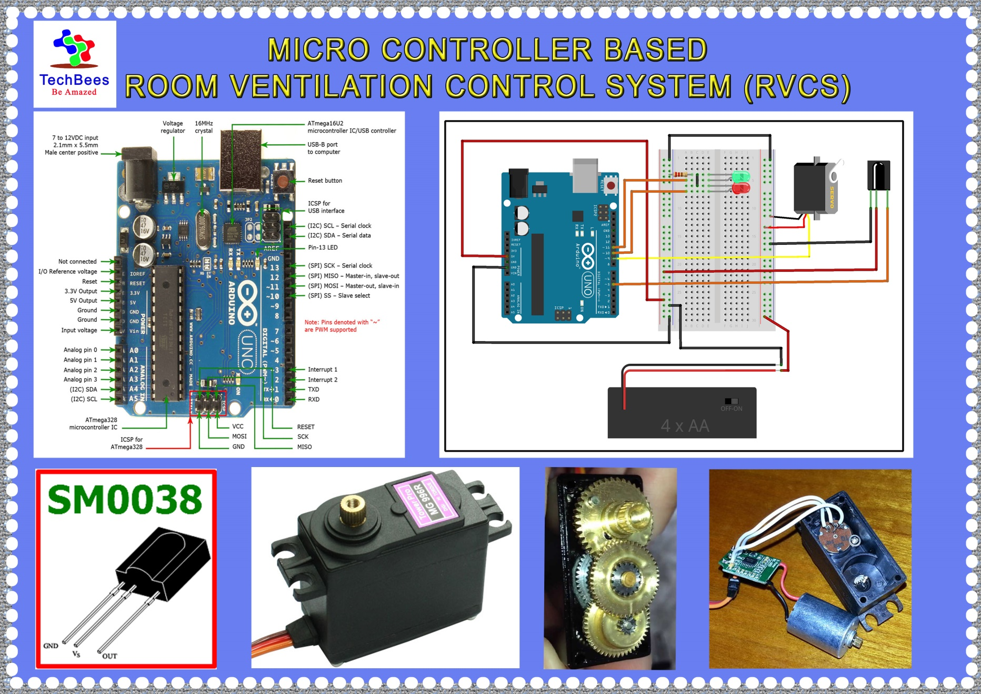

Slide 13
Advantages
The RVCS prevents suffocation in rooms fixed with AC which need heat insulation in ventilators and prevents unnoticed health hazards.
The system is controlled by the same remote and uses signal for controlling the AC and needs no other control gadget.
The basic RVCS system can be fabricated with less than 10% cost that is required for an AC.

Slide 14
Easy to install and operate.
Same power wiring for AC can be used for RVCS.
The RVCS can also be fitted in rooms without AC to regulate air flow based on temperature and Humidity sensor values and can be controlled by inexpensive remotes.

Slide 15
Scope
To develop the model into a commercial product considering its health benefits and the low cost involved.
The commercial product can be developed with temperature, humidity and CO₂ sensors, LCD Displays and additional venting fans to increase the efficiency and consumer preference.

Slide 16
Cost estimate
SL.No. | ITEM | COST (Rs.)
1 | Mechanical Ventilation Closure system | 4500
2 | Micro controller and basic sensors | 1500
3 | Software Design | 1000
3 | PCB Design and fabrication | 1000
4 | Power system | 1000
5 | Unforeseen Expenses | 1000
 | Total | 10000

Slide 17
Thank You

